Slide 1
COMP 6699 – Object Oriented Programming
Session 10
Interfaces
Jude J.L. Martinez
jmartinez@binus.edu

Slide 2
Session Learning Outcomes
Upon completion of this session, students are expected to be able to
Declare and use interface types
Understand the concept of polymorphism
Appreciate how interfaces can be used to decouple classes
Implement helper classes as inner classes

Slide 3
CHAPTER 9
INTERFACES AND POLYMORPHISM

Slide 4
CHAPTER GOALS
To learn about interfaces
To be able to convert between supertype and subtype references
To understand the concept of polymorphism
To appreciate how interfaces can be used to decouple classes
To learn how to implement helper classes as inner classes
To understand how inner classes access variables from the surrounding scope
To implement event listeners for timer events

Slide 5
Modifying DataSet for Bank Accounts
public class DataSet // modified for BankAccount objects
{ . . . public void add(BankAccount x) { sum = sum + x.getBalance(); if (count == 0 || maximum.getBalance() < x.getBalance()) maximum = x; count++; } public BankAccount getMaximum() { return maximum; } private double sum; private BankAccount maximum; private int count;
}

Slide 6
Modifying DataSet for Coins
public class DataSet // modified for Coin objects
{ . . . public void add(Coin x) { sum = sum + x.getValue(); if (count == 0 || maximum.getValue() < x.getValue()) maximum = x; count++; } public Coin getMaximum() { return maximum; } private double sum; private Coin maximum; private int count;
}

Slide 7
Measurable Interface
Suppose various classes could agree on the same method name, getMeasure
Then DataSet could call that method:
sum = sum + x.getMeasure(); if (count == 0 || maximum.getMeasure() < x.getMeasure()) maximum = x;
Define an interface: public interface Measurable { double getMeasure(); }

Slide 8
Interfaces vs. Classes
All methods in an interface are abstract--no implementation
All methods in an interface are automatically public
An interface doesn't have instance fields

Slide 9
Generic DataSet for Measurable Objects
public class DataSet // modified for Coin objects
{ . . . public void add(Measurable x) { sum = sum + x.getMeasure(); if (count == 0 || maximum.getMeasure() < x.getMeasure()) maximum = x; count++; } public Measurable getMaximum() { return maximum; } private double sum; private Measurable maximum; private int count;
}

Slide 10
Realizing an Interface
Class names interface(s) in implements clause
Class supplies definitions of interface methods class ClassName implements Measurable { public double getMeasure() { implementation } additional methods and fields }
The class must define the methods as public

Slide 11
Making BankAccount and Coin Classes Measurable
class BankAccount implements Measurable
{ public double getMeasure() { return balance; } additional methods and fields
}
class Coin implements Measurable
{ public double getMeasure() { return value; } additional methods and fields
}

Slide 12
File DataSetTest.java
1 /**
2 This program tests the DataSet class.
3 */
4 public class DataSetTest
5 {
6 public static void main(String[] args)
7 {
8
9 DataSet bankData = new DataSet();
10
11 bankData.add(new BankAccount(0));
12 bankData.add(new BankAccount(10000));
13 bankData.add(new BankAccount(2000));
14
15 System.out.println("Average balance = "
16 + bankData.getAverage());
17 Measurable max = bankData.getMaximum();

Slide 13
18 System.out.println("Highest balance = "
19 + max.getMeasure());
20
21 DataSet coinData = new DataSet();
22
23 coinData.add(new Coin(0.25, "quarter"));
24 coinData.add(new Coin(0.1, "dime"));
25 coinData.add(new Coin(0.05, "nickel"));
26
27 System.out.println("Average coin value = "
28 + coinData.getAverage());
29 max = coinData.getMaximum();
30 System.out.println("Highest coin value = "
31 + max.getMeasure());
32 }
33 }

Slide 14
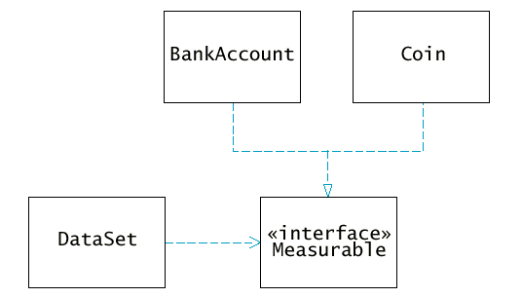
UML Diagram of DataSet and Related Classes
Note that DataSet is decoupled from BankAccount, Coin

Slide 15
Syntax 9.1: Defining an Interface
public interface InterfaceName
{ method signatures
}
Example:
public interface Measurable { double getMeasure(); }
Purpose:
To define an interface and its method signatures. The methods are automatically public.

Slide 16
Syntax 9. 2: Implementing an Interface
public class ClassName implementsInterfaceName, InterfaceName, ... { methods instance variables }
Example:
public class BankAccount implements Measurable { // other BankAccount methods public double getMeasure() { // method implementation } }
Purpose:
To define a new class that implements the methods of an interface

Slide 17
Converting Between Types
Can convert from class type to realized interface type: BankAccount account = new BankAccount(10000); Measurable x = account; // OK
Same interface type variable can hold reference to Coin x = new Coin(0.1, "dime"); // OK
Cannot convert between unrelated types x = new Rectangle(5, 10, 20, 30); // ERROR

Slide 18
Casts
Add coin objects to DataSet DataSet coinData = new DataSet(); coinData.add(new Coin(0.25, "quarter")); coinData.add(new Coin(0.1, "dime")); ...
Get largest coin with getMaximum method: Measurable max = coinData.getMaximum();
What can you do with it? It's not of type Coin String name = max.getName(); // ERROR
You know it's a coin, but the compiler doesn't. Apply a cast: Coin maxCoin = (Coin)max; String name = maxCoin.getName();
If you are wrong and max isn't a coin, the compiler throws an exception

Slide 19
The instanceof Operator
Use instanceof for safe casts:
if (max instanceof Coin) { Coin maxCoin = (Coin)max; . . . }

Slide 20
Syntax 9.3: The instanceof Operator
object instanceof ClassName
Example:
if (x instanceof Coin) { Coin c = (Coin)x; }
Purpose:
To return true if the object is an instance of ClassName (or one of its subclasses), false otherwise

Slide 21
Polymorphism
Interface variable holds reference to object of a class that realizes the interface Measurable x; x = new BankAccount(10000); x = new Coin(0.1, "dime");
You can never construct an interface! x = new Measurable(); // ERROR
You can call any of the interface methods: double m = x.getMeasure(); // OK
Which method is called?

Slide 22
Polymorphism
Depends on the actual object.
If x refers to a bank account, calls BankAccount.getMeasure
If x refers to a coin, calls Coin.getMeasure
Polymorphism (greek: many shapes): The type of the object determines the method to call
Called late binding. Resolved at runtime
Different from overloading. Overloading is resolved by the compiler.

Slide 23
Using a Strategy Interface
Drawbacks of Measurable interface:
must modify class, add interface and method
can measure a class in only one way
Remedy: Hand the object to be measured to a method:
public interface Measurer { double measure(Object anObject); }
Object is the "lowest common denominator" of all classes

Slide 24
Using a Strategy Interface
add method asks measurer (and not the added object) to do the measuring
public void add(Object x)
{ sum = sum + measurer.measure(x); if (count == 0 || measurer.measure(maximum) < measurer.measure(x)) maximum = x; count++;
}

Slide 25
Using a Strategy Interface
Measure rectangle area
class RectangleMeasurer implements Measurer { public double measure(Object anObject) { Rectangle aRectangle = (Rectangle)anObject; double area = aRectangle.getWidth() * aRectangle.getHeight(); return area; } }
Must cast from Object to Rectangle
Pass measurer to data set constructor: Measurer m = new RectangleMeasurer(); DataSet data = new DataSet(m);

Slide 26
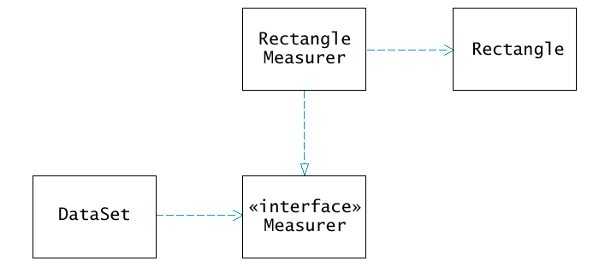
UML Diagram of Measurer Interface and Related Classes
Note that the Rectangle class is decoupled from the Measurer interface

Slide 27
Inner Classes
Trivial class can be defined inside a method
public static void main(String[] args) { class RectangleMeasurer implements Measurer { . . . } Measurer m = new RectangleMeasurer(); . . . // RectangleMeasurer class not used beyond this point }

Slide 28
File DataSet.java
1 /**
2 Computes the average of a set of data values.
3 */
4 public class DataSet
5 {
6 /**
7 Constructs an empty data set with a given measurer
8 @param aMeasurer the measurer that is used to measure data values
9 */
10 public DataSet(Measurer aMeasurer)
11 {
12 sum = 0;
13 count = 0;
14 maximum = null;
15 measurer = aMeasurer;
16 }
17

Slide 29
18 /**
19 Adds a data value to the data set
20 @param x a data value
21 */
22 public void add(Object x)
23 {
24 sum = sum + measurer.measure(x);
25 if (count == 0
26 || measurer.measure(maximum) < measurer.measure(x))
27 maximum = x;
28 count++;
29 }
30
31 /**
32 Gets the average of the added data.
33 @return the average or 0 if no data has been added
34 */
35 public double getAverage()
36 {
37 if (count == 0) return 0;

Slide 30
38 else return sum / count;
39 }
40
41 /**
42 Gets the largest of the added data.
43 @return the maximum or 0 if no data has been added
44 */
45 public Object getMaximum()
46 {
47 return maximum;
48 }
49
50 private double sum;
51 private Object maximum;
52 private int count;
53 private Measurer measurer;
54 }

Slide 31
File DataSetTest.java
1 import java.awt.Rectangle;
2
3 /**
4 This program demonstrates the use of a Measurer.
5 */
6 public class DataSetTest
7 {
8 public static void main(String[] args)
9 {
10 class RectangleMeasurer implements Measurer
11 {
12 public double measure(Object anObject)
13 {
14 Rectangle aRectangle = (Rectangle)anObject;
15 double area
16 = aRectangle.getWidth() * aRectangle.getHeight();
17 return area;

Slide 32
18 }
19 }
20
21 Measurer m = new RectangleMeasurer();
22
23 DataSet data = new DataSet(m);
24
25 data.add(new Rectangle(5, 10, 20, 30));
26 data.add(new Rectangle(10, 20, 30, 40));
27 data.add(new Rectangle(20, 30, 5, 10));
28
29 System.out.println("Average area = " + data.getAverage());
30 Rectangle max = (Rectangle)data.getMaximum();
31 System.out.println("Maximum area = " + max);
32 }
33 }

Slide 33
File Measurer.java
1 /**
2 Describes any class whose objects can measure other objects.
3 */
4 public interface Measurer
5 {
6 /**
7 Computes the measure of an object.
8 @param anObject the object to be measured
9 @return the measure
10 */
11 double measure(Object anObject);
12 }

Slide 34
Syntax 9.4: Inner Classes
Declared inside a method class OuterClassName { method signature { . . . class InnerClassName { nethods fields } . . . } . . . }

Slide 35
Declared inside a class class OuterClassName { nethods fields accessSpecifier class InnerClassName { nethods fields } . . . } Example:
public class Test { public static void main(String[] args) { class RectangleMeasurer implements Measurer { . . . } } } Purpose:
To define an inner class whose methods have access to the same variables and methods as the outer class methods

Slide 36
Processing Timer Events
javax.swing.Timer generates equally spaced timer events class
Sends events to action listener public interface ActionListener { void actionPerformed(ActionEvent event); }
Realize the interface class MyListener implements ActionListener { void actionPerformed(ActionEvent event); { // this action will be executed at each timer event place listener action here } }
Add listener to timer MyListener listener = new MyListener(); Timer t = new Timer(interval, listener); t.start();

Slide 37
Example: Countdown
Program prints
10 9 . . . 2 1 0 Liftoff!
One second delay between printouts

Slide 38
File TimerTest.java
1 import java.awt.event.ActionEvent;
2 import java.awt.event.ActionListener;
3 import javax.swing.JOptionPane;
4 import javax.swing.Timer;
5
6 /**
7 This program tests the Timer class.
8 */
9 public class TimerTest
10 {
11 public static void main(String[] args)
12 {
13 class CountDown implements ActionListener
14 {
15 public CountDown(int initialCount)
16 {
17 count = initialCount;

Slide 39
18 }
19
20 public void actionPerformed(ActionEvent event)
21 {
22 if (count >= 0)
23 System.out.println(count);
24 if (count == 0)
25 System.out.println("Liftoff!");
26 count--;
27 }
28
29 private int count;
30 }
31
32 CountDown listener = new CountDown(10);
33
34 final int DELAY = 1000; // milliseconds between timer ticks
35 Timer t = new Timer(DELAY, listener);
36 t.start();
37

Slide 40
38 JOptionPane.showMessageDialog(null, "Quit?");
39 System.exit(0);
40 }
41 }

Slide 41
Example: Add Interest
Define bank account object public class TimerTest { public static void main(String[] args) { final BankAccount account = new BankAccount(1000); class InterestAdder implements ActionListener { . . . }
} private static final double RATE = 5;
}
final modifier of account necessary so inner class code can access it

Slide 42
Inner Class Can Access Outer Variables
class InterestAdder implements ActionListener { public void actionPerformed(ActionEvent event) { double interest = account.getBalance() * RATE / 100; account.deposit(interest); System.out.println("Balance = " + account.getBalance()); } }
Inner class can access all fields and methods of outer class
Inner class can access all final variables of enclosing method

Slide 43
File TimerTest.java
1 import java.awt.event.ActionEvent;
2 import java.awt.event.ActionListener;
3 import javax.swing.JOptionPane;
4 import javax.swing.Timer;
5
6 /**
7 This program uses a timer to add interest to a bank
8 account once per second.
9 */
10 public class TimerTest
11 {
12 public static void main(String[] args)
13 {
14 final BankAccount account = new BankAccount(1000);
15
16 class InterestAdder implements ActionListener
17 {

Slide 44
18 public void actionPerformed(ActionEvent event)
19 {
20 double interest = account.getBalance() * RATE / 100;
21 account.deposit(interest);
22 System.out.println("Balance = "
23 + account.getBalance());
24 }
25 }
26
27 InterestAdder listener = new InterestAdder();
28
29 final int DELAY = 1000; // milliseconds between timer ticks
30 Timer t = new Timer(DELAY, listener);
31 t.start();
32
33 JOptionPane.showMessageDialog(null, "Quit?");
34 System.exit(0);
35 }
36
37 private static final double RATE = 5;
38 }

Slide 45
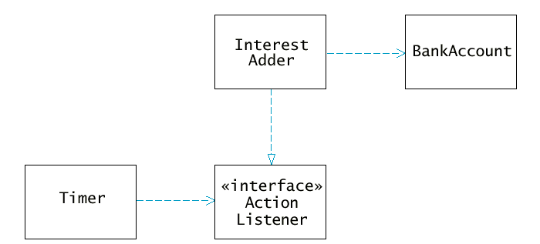
UML Diagram of Timer Classes

